Slide 1
Sprint Retrospective SIT 223
By GROUP 5

Slide 2
GROUP MEMBERS
HARSHIT SAXENA 218699327 HD
JACK LENIGAS 218138603 HD
RINA KOUCH 219162014 HD
TUSHAR 217575769 HD

Slide 3
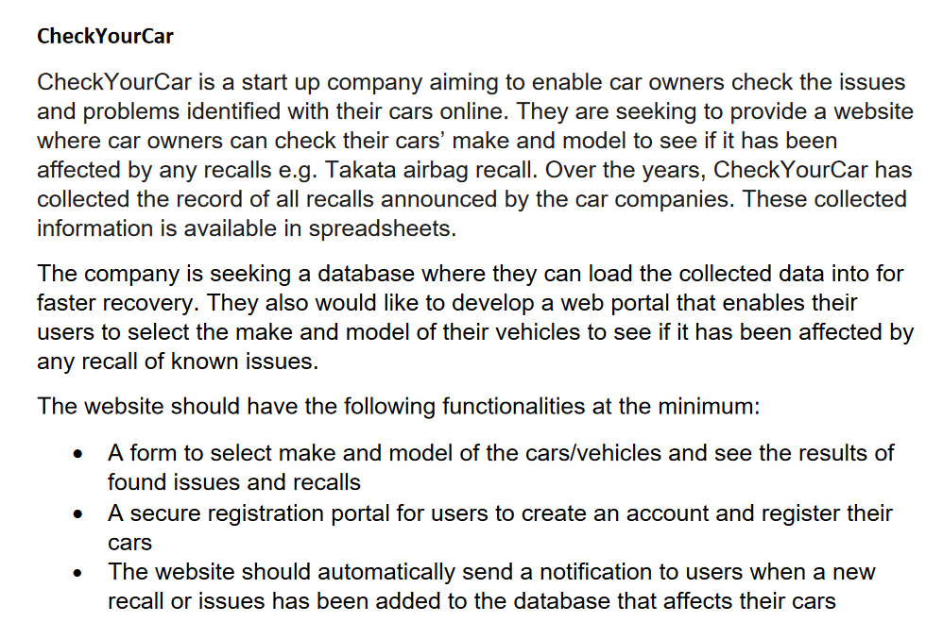
PROJECT A

Slide 4

Project Overview
CheckYourCar (Online service and
database)
Agile Project Management
Three Main Features
A form to select make and model of the
cars/vehicles and see the results of found
issues and recalls
A secure registration portal for users to
create an account and register their cars
The website should automatically send a
notification to users when a new recall or issue has been added to the
database that affects their cars

Slide 5
AGILE SCRUM METHODOLGIES
Agile scrum methodology is a project management system that relies on incremental development. Each iteration consists of two- to four-week sprints, where each sprint's goal is to build the most important features first and come out with a potentially deliverable product.
used primarily for software development projects with the goal of delivering new software capability every 2-4 weeks.
According to the 12th annual State of Agile report, 70% of software teams all across globe use Scrum or a Scrum hybrid.

Slide 6

AGILE SCRUM BENEFITS
Higher productivity
Better-quality products
Reduced time to market
Improved stakeholder satisfaction
Better team dynamics
Happier employees

Slide 7
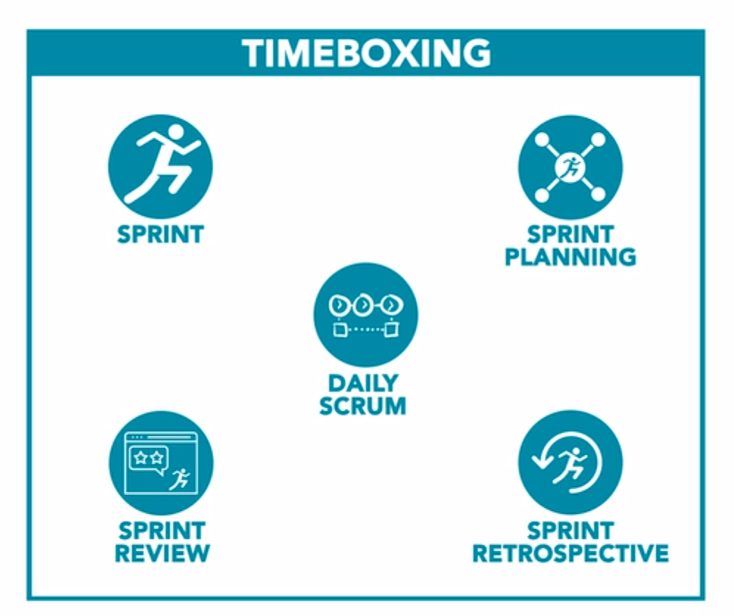
AGILE SCRUM EVENTS
The Sprint
Sprint Planning Sprint
The Daily Stand Up
The Sprint Review
The Retrospective

Slide 8
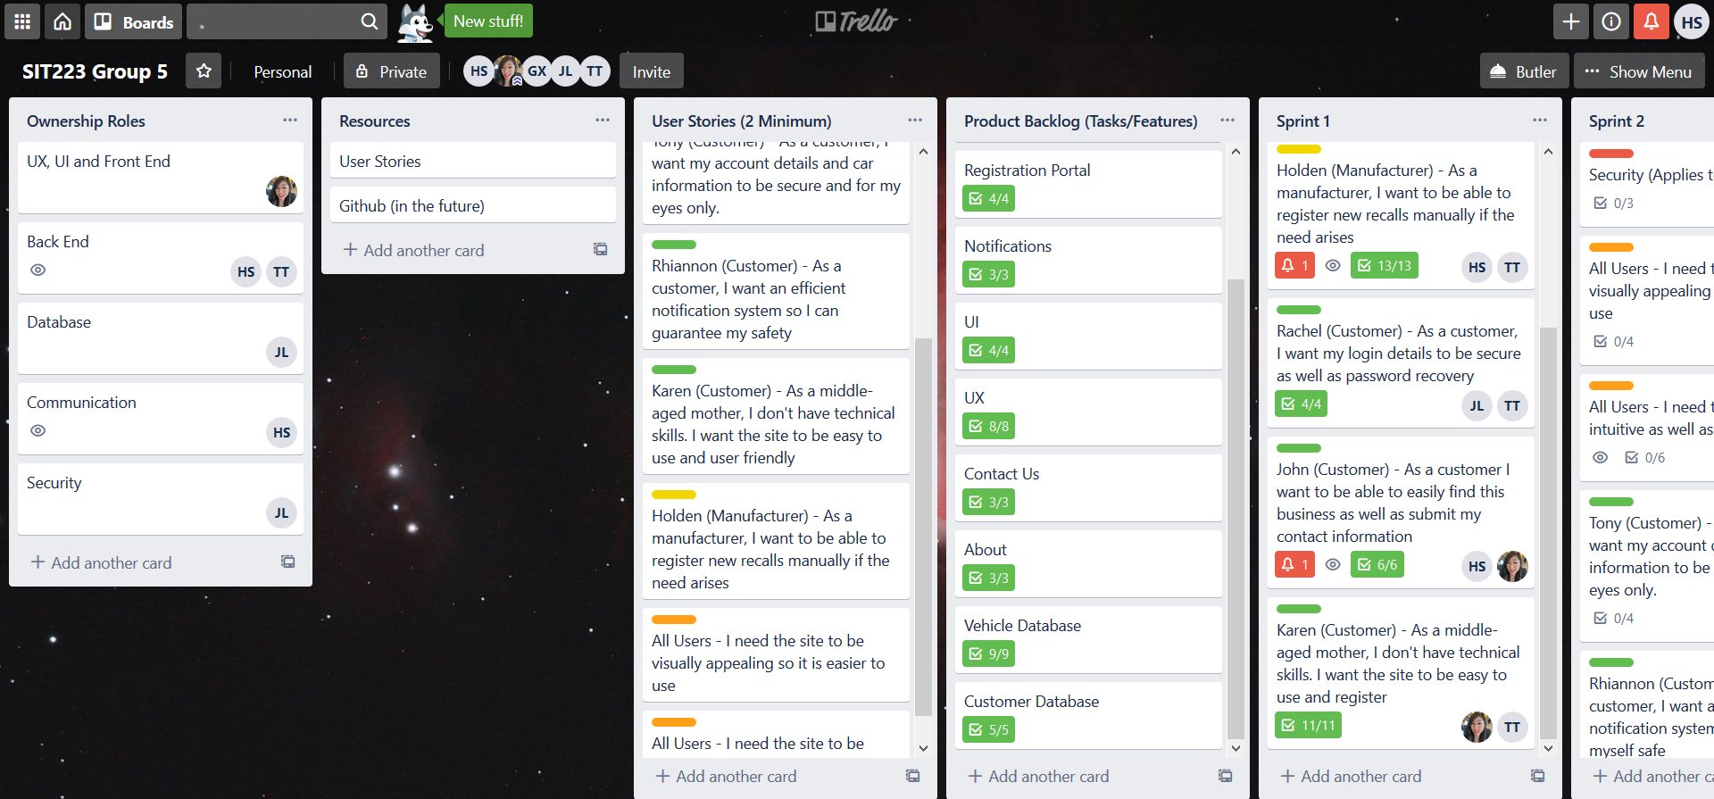
OUR TRELLO BOARD

Slide 9
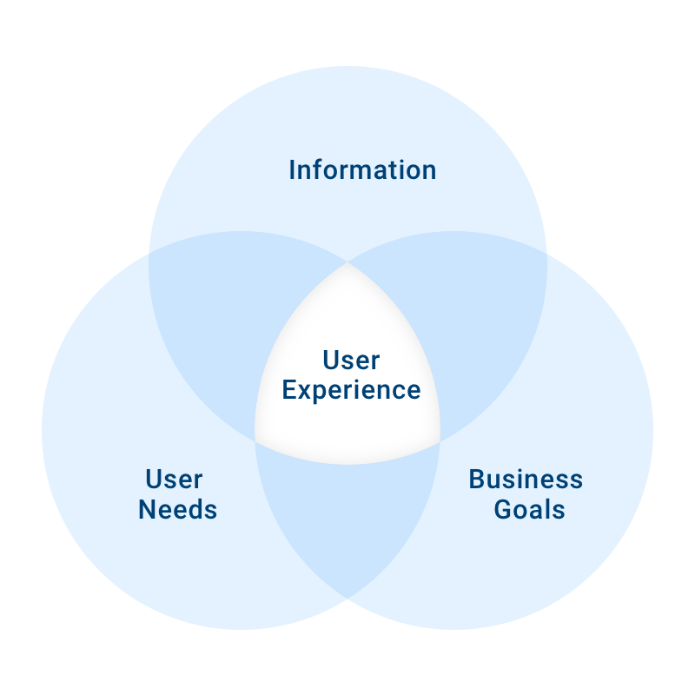
Project Logistics
Much more functionality than the 3 main features
Would need to be much more in-depth if security
was to be necessary
10 Features
Over 50 individual sub features
Figuring out what to split into each sprint was a
challenge
Decided on leaving security, UI and UX for sprint 2
as we need to create a barebones functional project
first

Slide 10
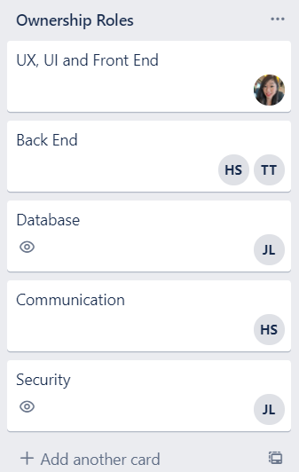
Sprint Planning (Ownership roles)
some members have multiple roles
Backend is a colossal job, hence more members assigned
Everyone assigned themselves based on
their specialities and expertise

Slide 11
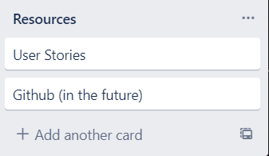
Sprint Planning (Resources)
User stories were main source
of information
Github, to be implemented
later when getting into more
complicated areas of
the project

Slide 12
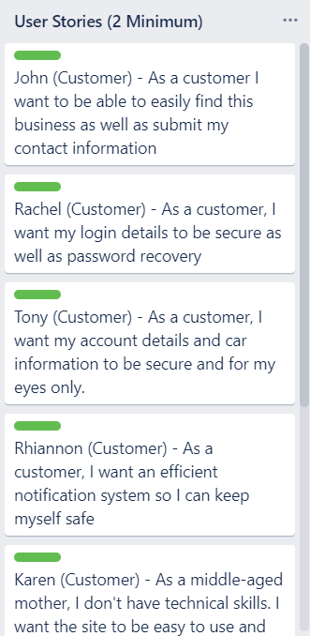
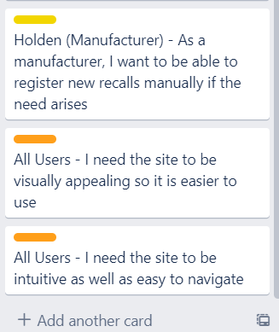
Sprint Planning (User Stories)
An integral part of the planning process
Created stories based on user needs
Used these stories in order to
choose which features to implement
Labelling system

Slide 13
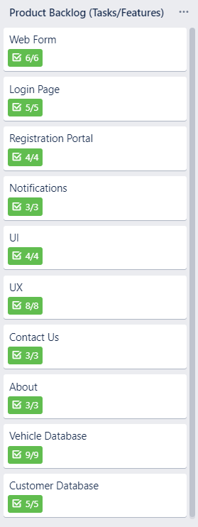
Sprint Planning (Features/Tasks)
10 features
50 sub-features
Created them based on user stories
Were assigned to user stories
later in the planning process
Used Checklists to correctly
assign each feature to stories later

Slide 14
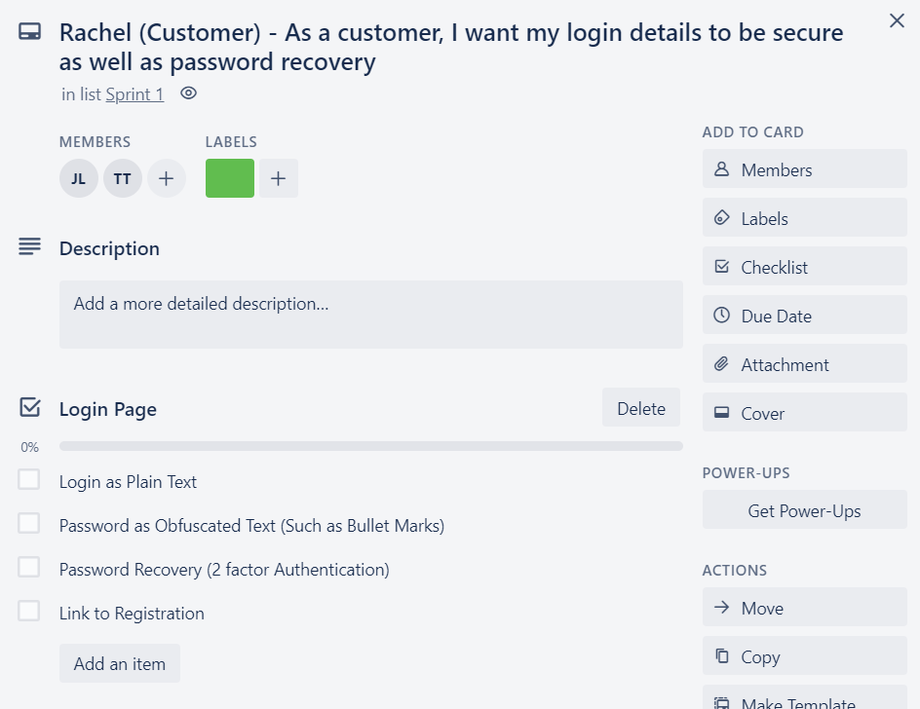
Sprint Planning (Story Points)
Assigning tasks/features to each user
story
Helps to organise and sort through
what needed to be done
Added checklists for each
feature/sub-feature
These story points were sorted into
sprints

Slide 15
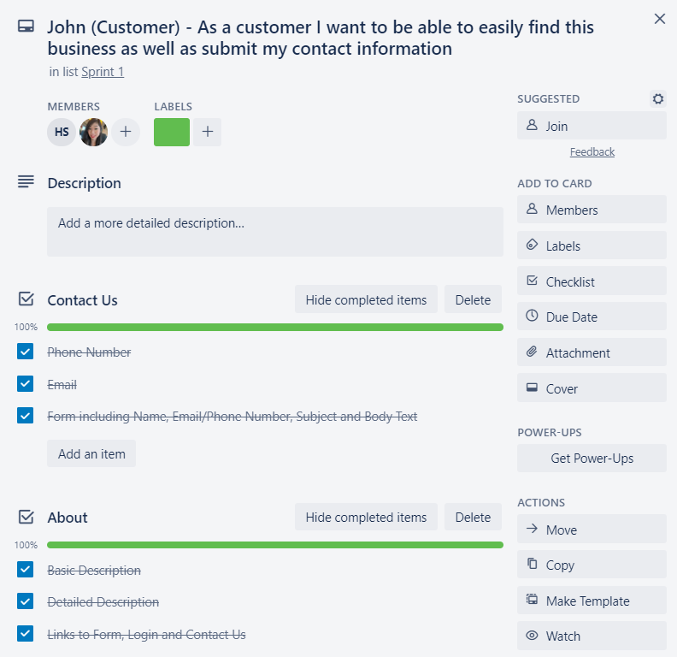
Sprint 1
Trusted each member to do
their part
Ticked off each feature as it
was implemented
Regular calls for updates
Got everything done in time for
sprint 2

Slide 16
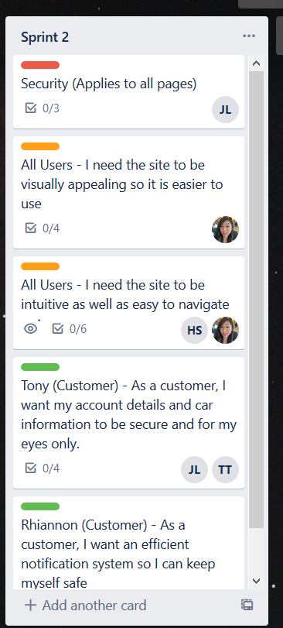
Sprint 2 Plan
Going into sprint 2 with an idea of what we had the most trouble with will ultimately help in our planning and execution of the sprint. Firstly, while most of sprint 1 revolved around the idea of basic design and functionality in the website, sprint 2 will be focused more on the finer details, security and UI of the site. As a result of this, we will need to set up a github for the sprint as we get into more complicated iterations and versions of the codebase. In a team sense, we will need to be more responsible for our parts so that projects can be completed on time

Slide 17
RETROSPECTION
Issues Faced
Coronavirus/Isolation/Transfer to online work
Different sleep schedules
Availability differences day-to-day
Getting heads around agile management rather than traditional management

Slide 18
BIBLIOGRAPHY
https://www.atlassian.com/agile/project-management/user-stories
https://resources.collab.net/agile-101/what-is-scrum
https://github.com/
https://www.youtube.com/results?search_query=trello+tutorial+2019
https://www.youtube.com/results?search_query=users+stories+trello

Slide 19
REFLECTION
HARSHIT : TRELLO BOARD| PPT | PRESENTATION
JACK : TRELLO BOARD | PPT | PRESENTATION
RINA : TRELLO BOARD |PPT
TUSHAR : TRELLO BOARD

